Slide 1

Netflix Movies and TV shows dataset
Clustering and Classification Modelling
Varun Eranki

Slide 2
Idea and Purpose
People have a preference to story types while choosing movies
This could be something they are unaware of
Create clusters of movies with similar storyline or setting
Use those clusters to enhance recommender systems
Genre and Rating also help in recommendations

Slide 3
Data - Netflix Movies and TV shows dataset
Feature | Description
Show ID | Unique ID for every Movie / Tv Show
Type | Identifier - A Movie or TV Show
Title | Title of the Movie / Tv Show
Director | Director of the Movie
Cast | Actors involved in the movie / show
Country | Country where the movie / show was produced
Date added | Date it was added on Netflix
Release year | Actual Release year of the move / show
Rating | TV Rating of the movie / show
Duration | Total Duration - in minutes or number of seasons
Listed in | Genre
Description | The summary description

Slide 4
Methodology
Identify important features
Data Cleaning
Clustering to find similar movies
Classification to predict clusters

Slide 5
Identifying important features
Rating
TV-MA, R, PG-13, TV-14, TV-PG, NR, TV-G, TV-Y, TV-Y7, PG, G, NC-17, TV-Y7-FV, UR
To target the right kind of movie to the right audience
Genre
Crime, Horror, Drama, Anime, Comedy etc.
Helps in identifying similarities in storylines
Description
Helps in grouping similar stories or movies in similar settings

Slide 6
Data Cleaning (1) - Rating
Drop all other unwanted columns
Rating is a categorical column
One – hot encode the column values
Add as new features to the dataset

Slide 7
Data Cleaning (2) - Genre
Genre is a list of comma separated values
Identify all the unique genres
Create features for every genre and initialize the value to 0
Update new features to 1 by checking for genres in list

Slide 8
Data Cleaning (3) - Description
Build BERT contextual sentence embeddings
Sentence embeddings are numerical ways of representing a sentence
Reduced dimensions from 768 to 200 using UMAP
UMAP is a reduction technique that prevents loss of information

Slide 9
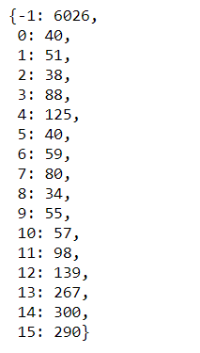
Clustering (1) - HDBSCAN
HDBSCAN - Hierarchical Density Based Clustering algorithm
Disregards outliers
Result does not help in building recommendations
Left most of the movies as outliers
Number of data points in every cluster

Slide 10
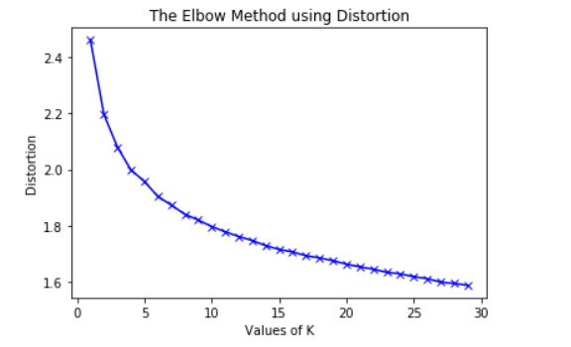
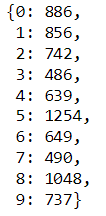
Clustering (2) – K-Means
Weighs every dimension equally to generate clusters
Tried on a range of clusters from 1 to 30
10 clusters – optimal
Evenly generated clusters with good strength in each of them
Number of data points in every cluster

Slide 11
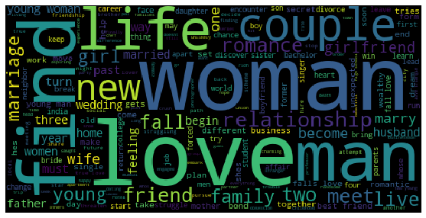
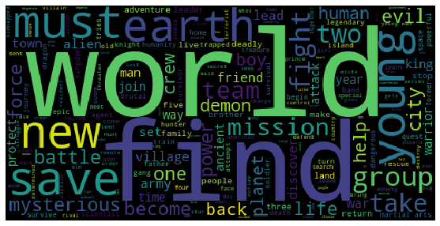
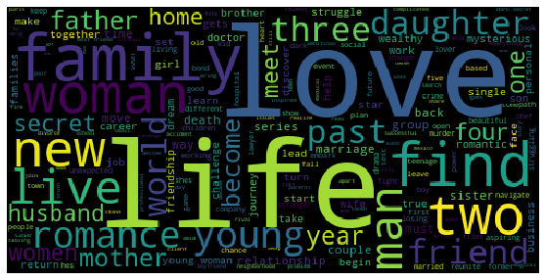
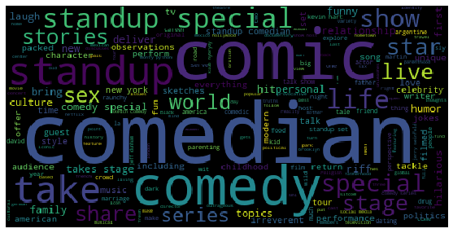
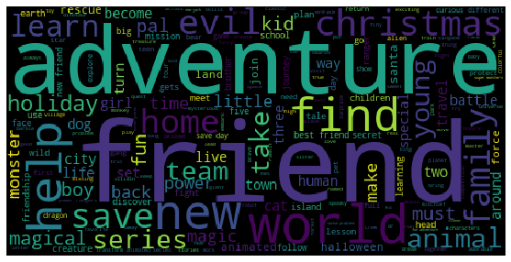
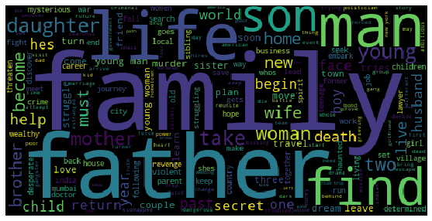
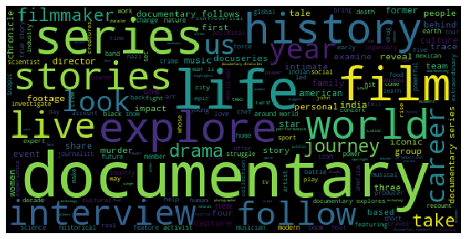
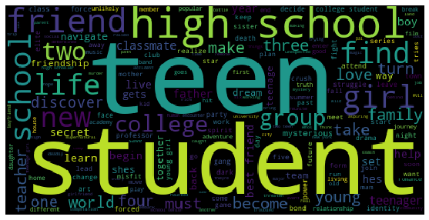
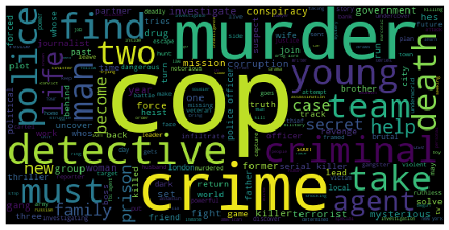
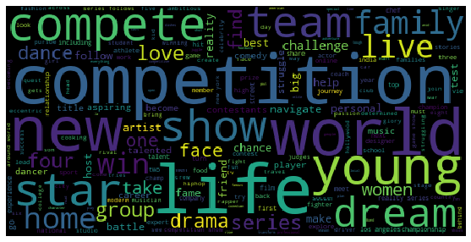
Visualization: Word Cloud of movie descriptions from every cluster

Slide 12
Breakdown of Word Cloud Visualizations
Cluster | Keywords in Descriptions | Story type identified
0 | Romance, Love, Life, Marry, Couple | ROMANTIC STORIES
1 | Documentary, Interview, True Story, History, Biopic | REAL LIFE EVENTS
2 | Family, Wife, Father, Son, Daughter, Brother | FAMILY STORIES
3 | Prison, Heist, Cop, Crime, Revenge | POLICE STORIES
4 | Relationship, Together, Husband, Wedding, Girlfriend | BONDING STORIES
5 | Teen, Student, High School, Friend, Young | COLLEGE LIFE STORIES
6 | Comedy, Comic, Standup, Comedian, Humor | COMEDY STORIES
7 | New, World, Adventure, Planet, Discover, Mysterious | ADVENTUROUS STORIES
8 | Murder, Mystery, Detective, Death, Investigate | CRIME STORIES
9 | World, travel, Explore, Live, Host, Food | TRAVEL STORIES

Slide 13
Classification – TensorFlow Model
Built a classification model using TensorFlow that predicts the clusters of movies
The sequence and context of words used are captured by the BERT sentence embeddings
A deep learning model with a simple architecture has been trained by 80-20 split and 5 - fold cross validation

Slide 14
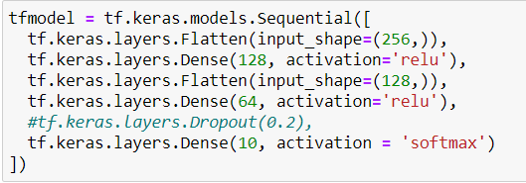
Model Architecture
Model has been trained for 50 epochs

Slide 15
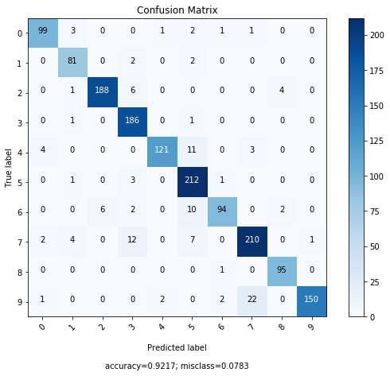
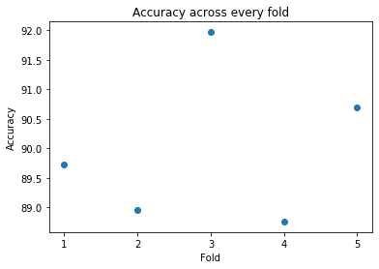
Results
Decent results on both Train – Test Split 80-20 and 5 fold cross validation
Accuracy of close to 90%

Slide 16
Future Work
This data can be combined with user specific data to build a profile for every user
Appropriate targeted recommendations can be made on such findings
Key takeaways
  Using BERT contextual sentence embeddings, machine learning algorithms can understand the meaning of sentences when represented in numeric format
  Similar movies can be grouped together by using these embeddings along with other features such as Rating and Genre

Slide 17

Thank You
Any Questions?

